Slide 1
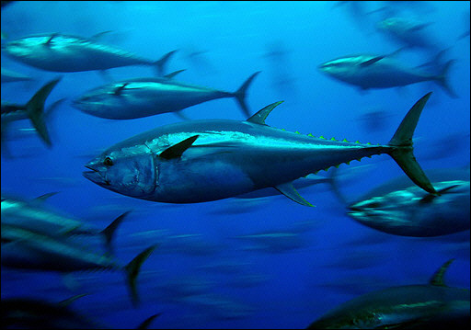





D A Kiefer, D P Harrison, M G Hinton, E M Armstrong, F J O’Brien
Pelagic Habitat Analysis Module (PHAM) for GIS Based Fisheries Decision Support
NASA Biodiversity and Ecological Prediction
April 23, 2013

Slide 2
“Using Oceanography for Fisheries Stock Assessment and Management”
11-14 October 2011 in La Jolla, CA.
Mark Maunder, who is stock assessment leader at the Inter-American Tropical Tuna Commission, began the workshop with a question to the national and international participants, “Does anyone know of any stock assessment models that currently incorporate environmental data into the calculations?”
No one raised their hand!

Slide 3
Pelagic Habitat Analysis Module (PHAM)
Fisheries Catch/Survey Data
Tagging Data
Satellite Imagery
Circulation Model
EASy GIS
PHAM Tools & Statistics
Dynamic Maps of Habitat
Data & Results of Statistical Analysis

Slide 4
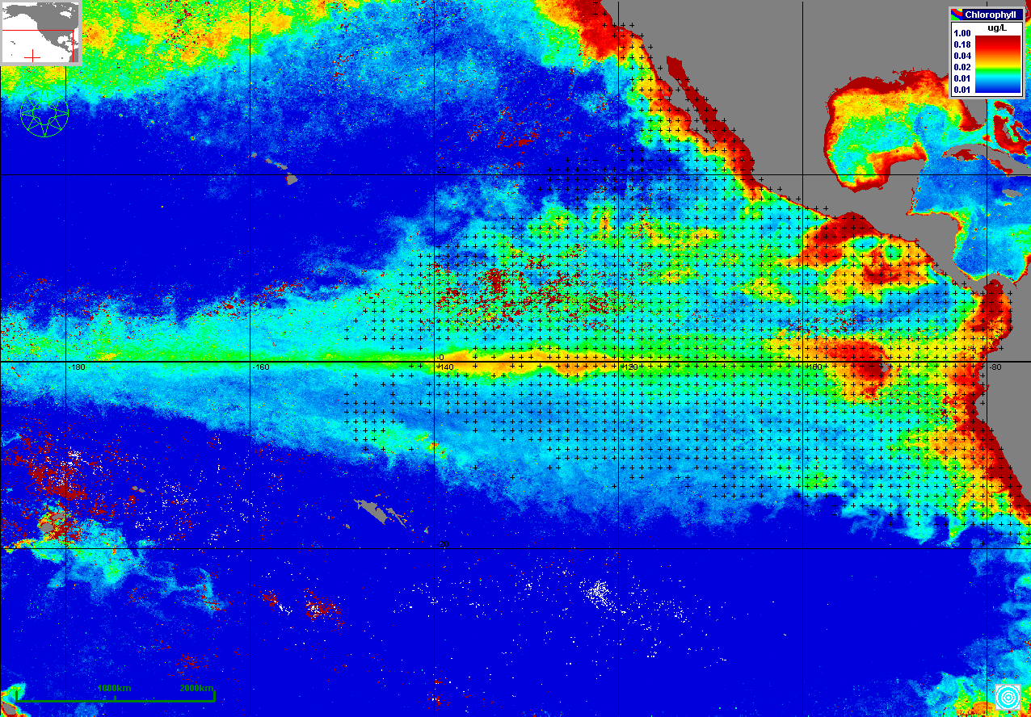
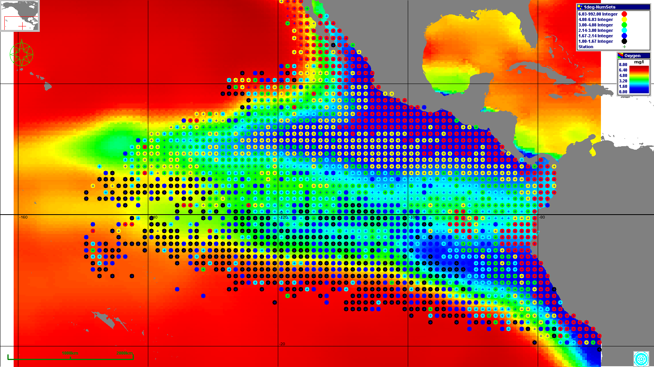
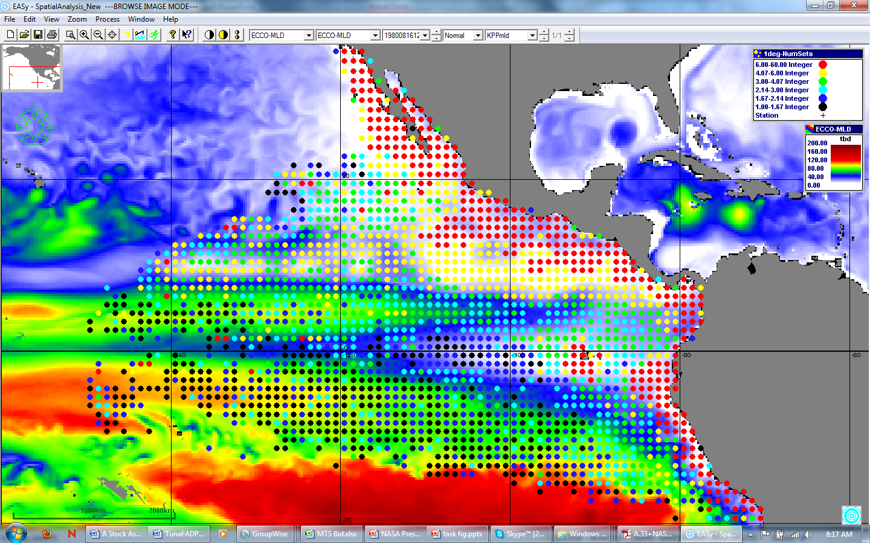
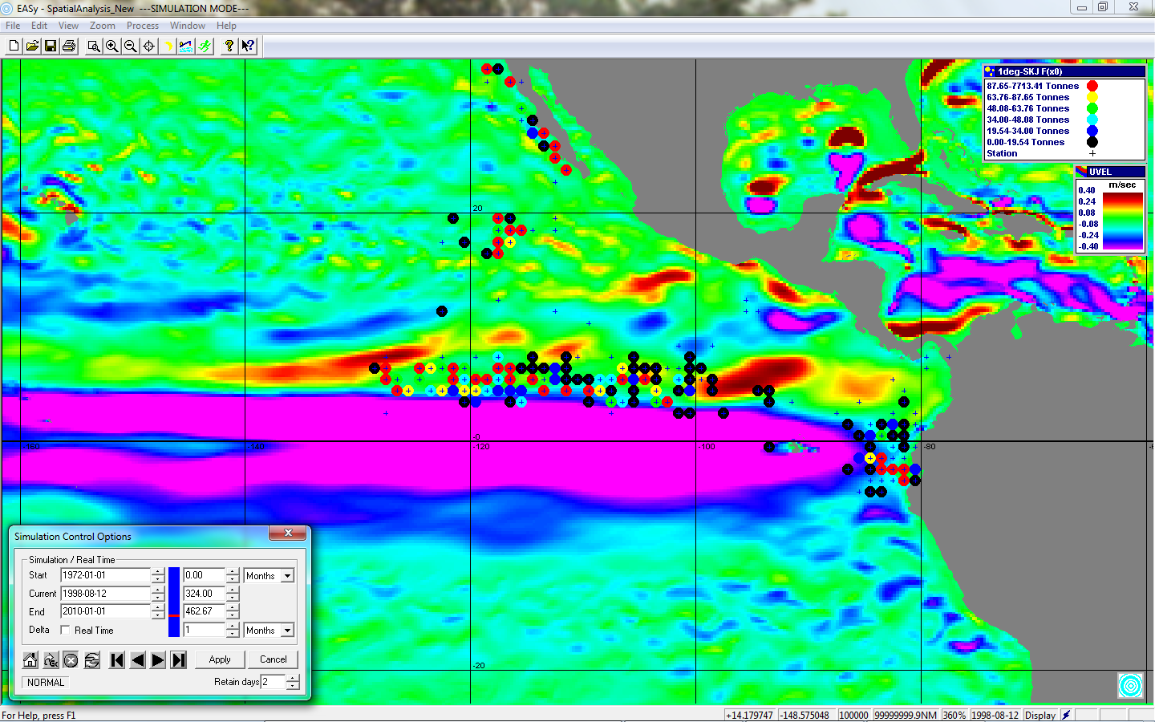
MODIS Chlorophyll
February 2007
Annual Average O2
at 150 m
N Equatorial current
Equatorial counterc
Equatorial current
August 79: average weekly sets overlying ECCO 2 mixed layer depth
August 98: Skipjack catch overlying
ECCO 2 meridional velocity

Slide 5
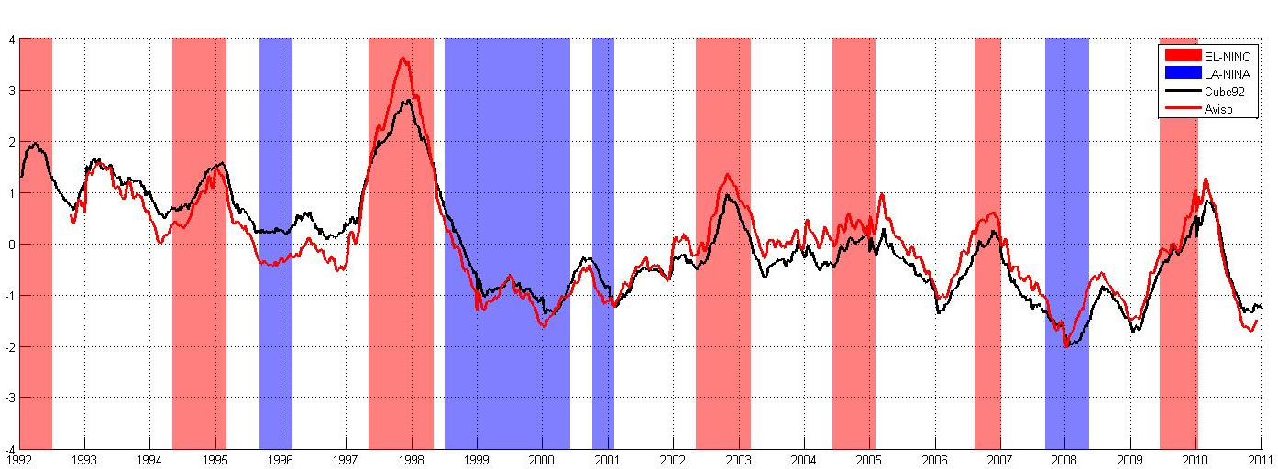
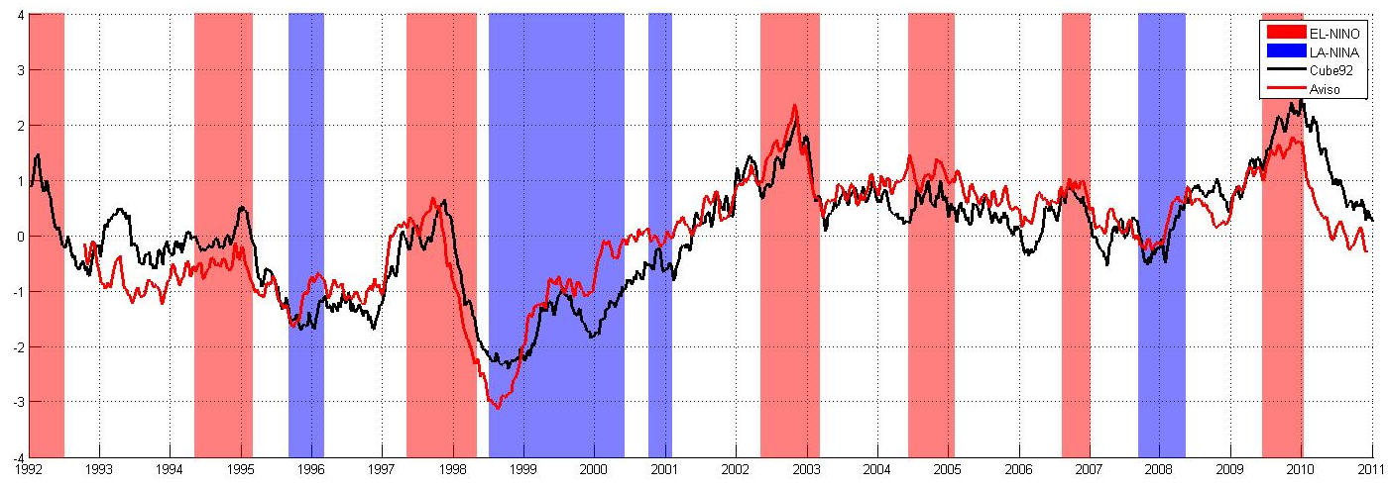
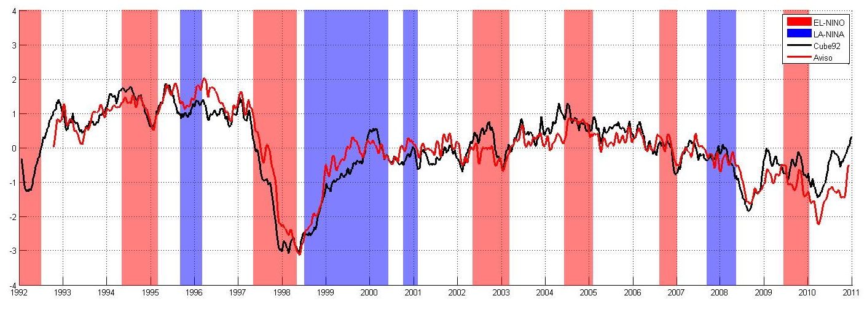
Model Validation: Comparison between Aviso satellite data and Cube92 model data
Mode1
Cube92: 16.54%
Aviso: 14.31%
Mode 2
Cube92: 6.16%
Aviso: 6.81%
Mode3
Cube92: 5.08%
Aviso: 4.43%
Notes:
Comparison

Slide 6
The Holy Grail of Stock Assessment Models: Recruitment!
Survival
Survival
Survival
Survival
Larvae
Juveniles
Recruits[ Age]
Adults[Age+1]
Adults[Age+i]
Spawning
Survival is a function of food availability and predation (both natural and human).
We have now incorporated into PHAM EOF analysis of time series information from satellites sea surface temperature, chlorophyll, and height and NASA’s ECCO 2 3-dimensional global circulation model. This analysis yields underlying patterns in spatial and temporal variability that are then compared by cross correlation analysis to the temporal patterns in recruitment.

Slide 7
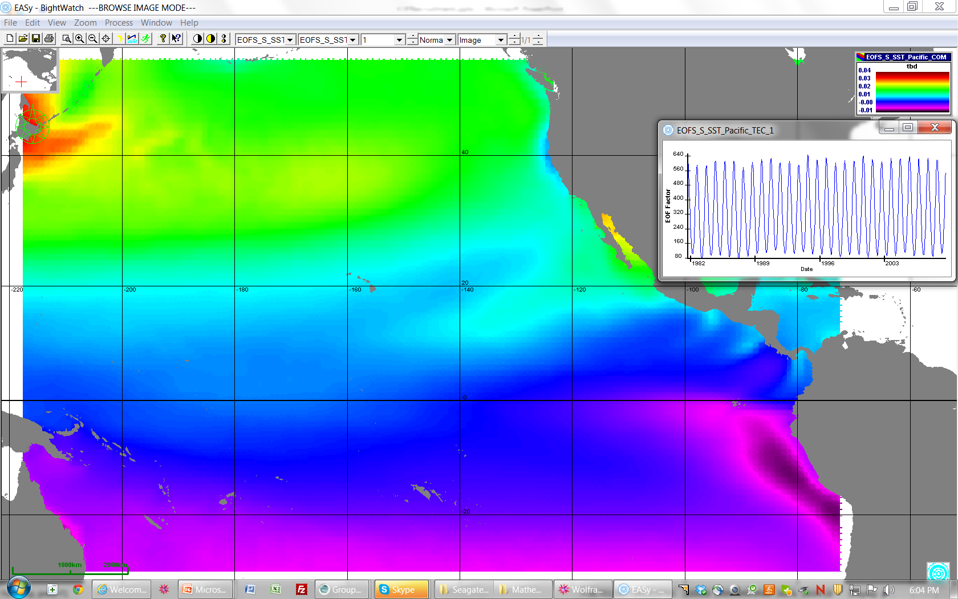
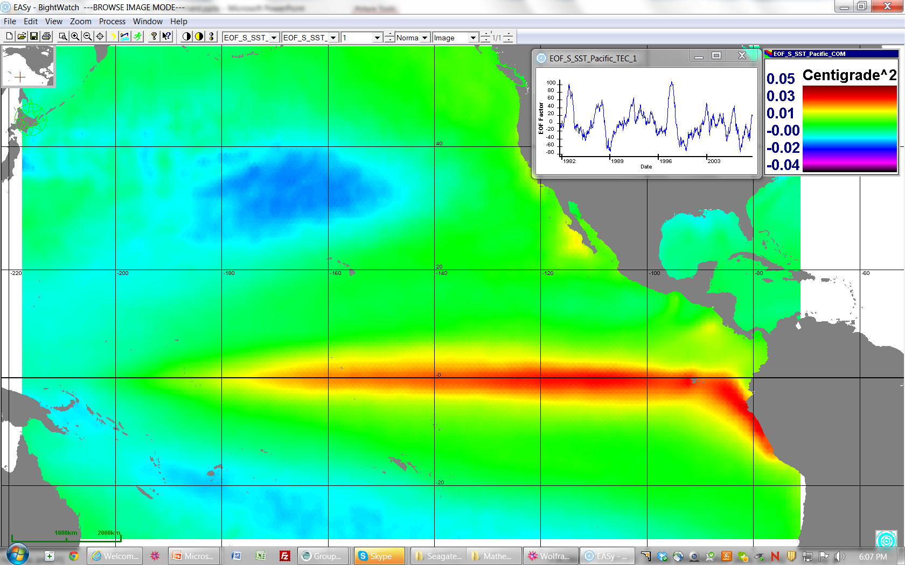
EOF 1st Seasonal Spatial Component & Temporal Expansion Coefficient
(right hand corner)
EOF 1st Nonseasonal Spatial Component & Temporal Expansion Coefficient
(right hand corner)

Slide 8
Correlation between temporal expansion coefficients and yellowfin recruitment lead to
hypothesis of temporal evolution.

Slide 9
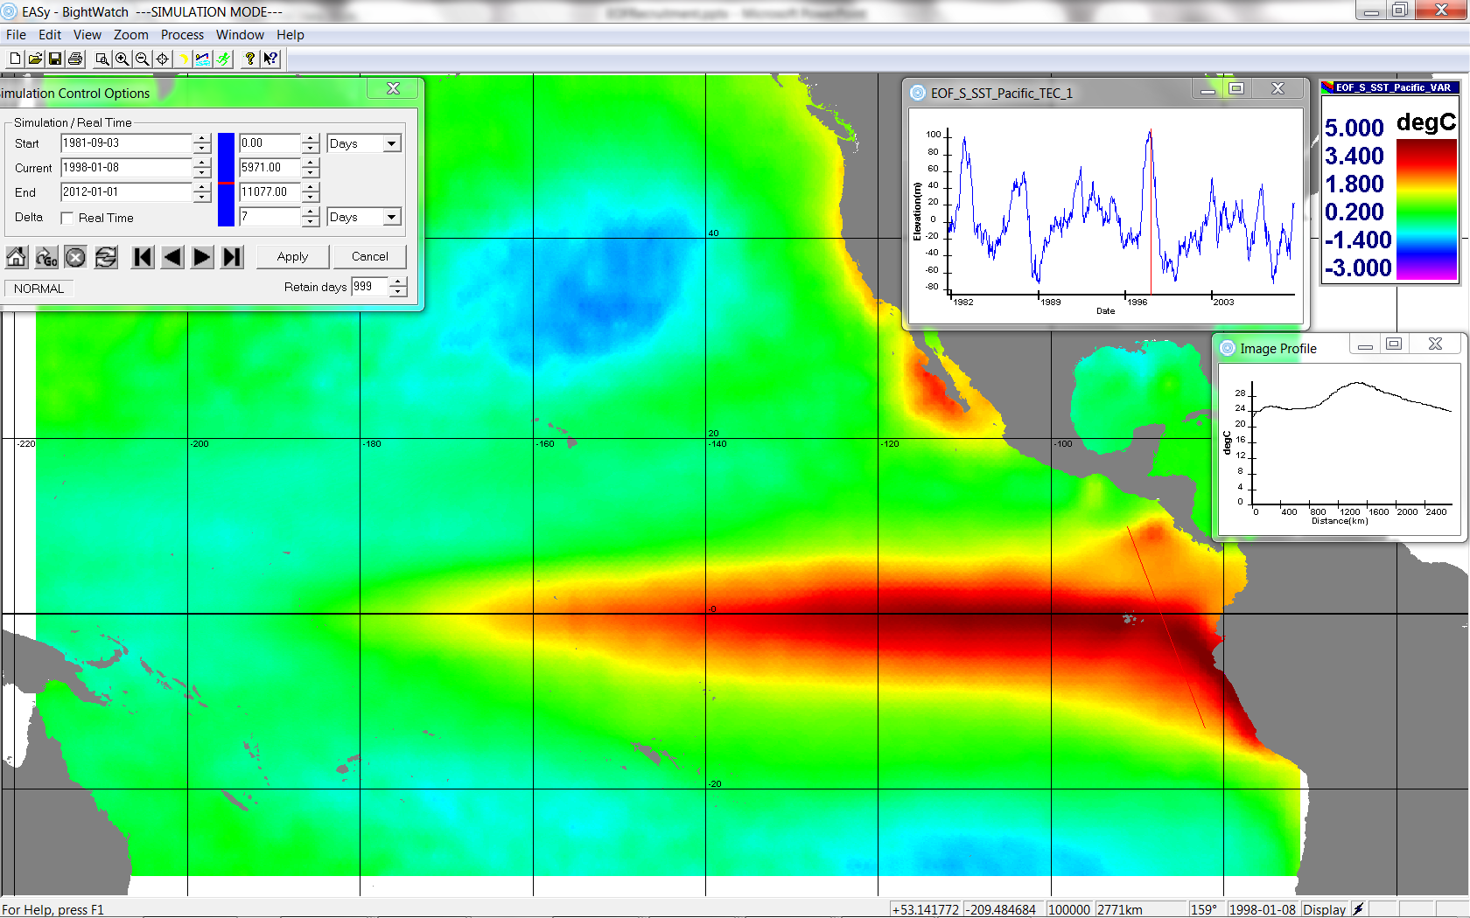
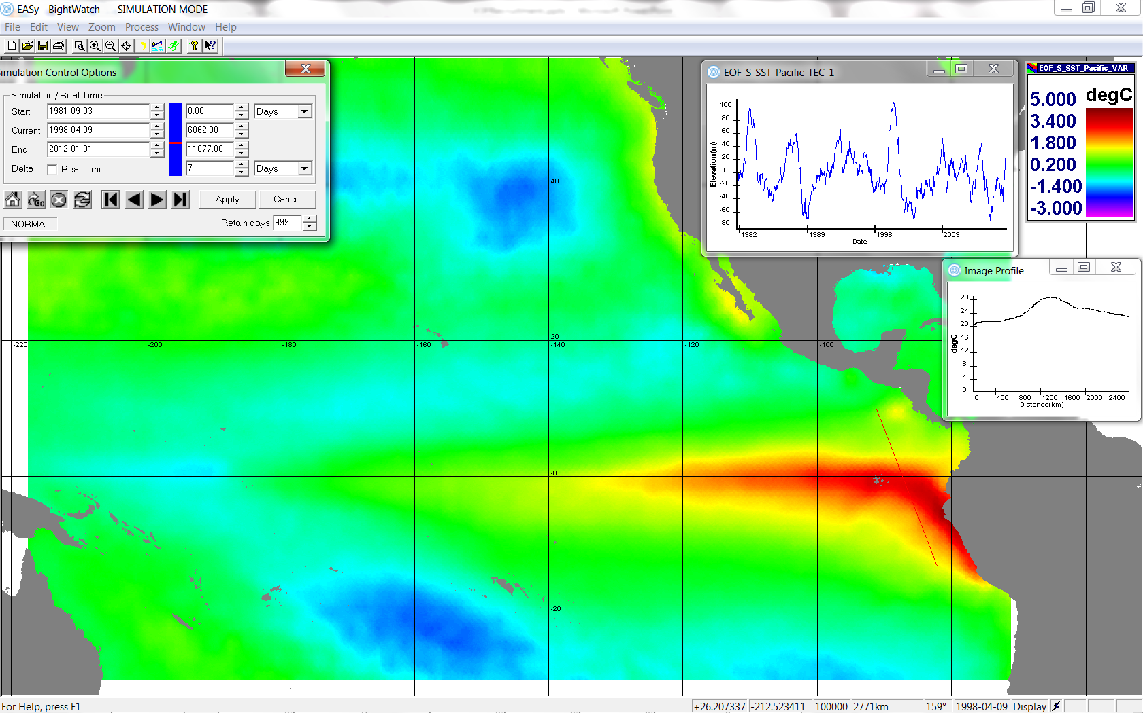
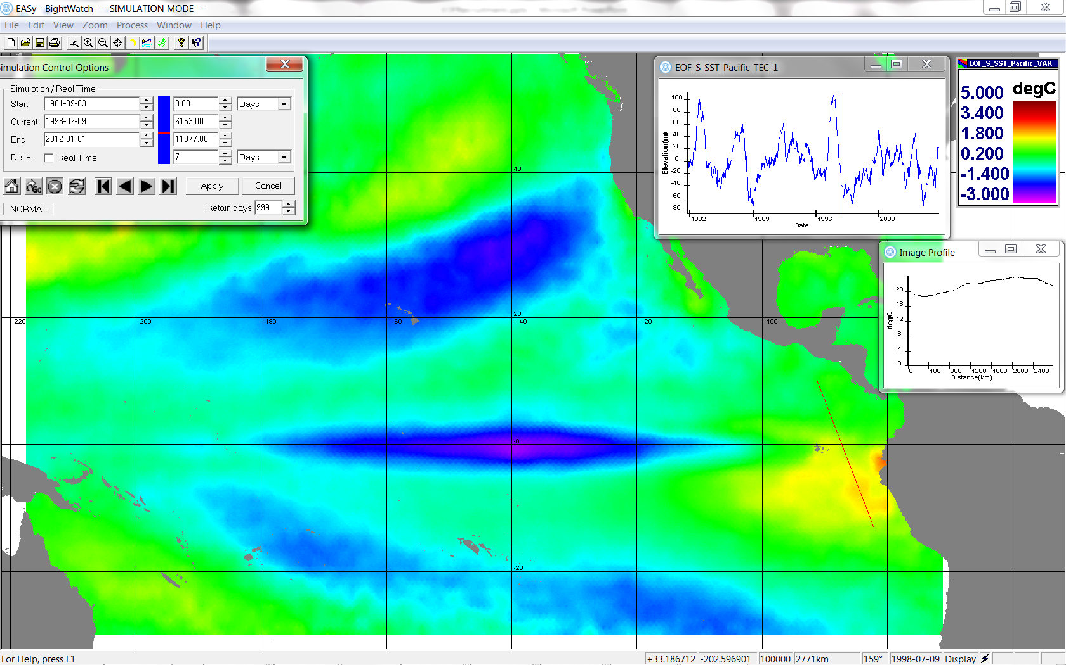
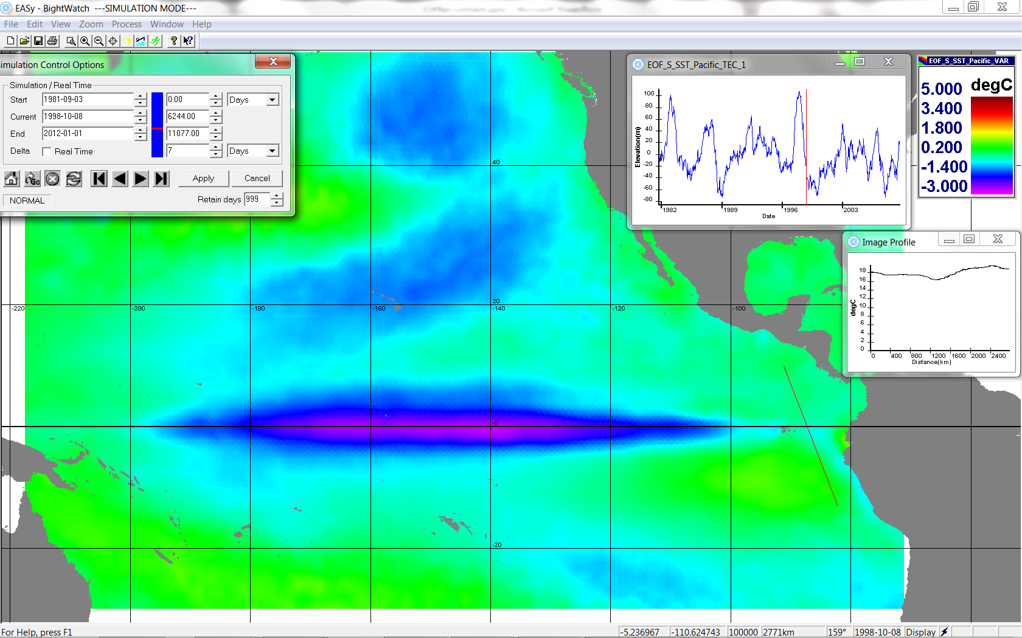
Snapshots of EOF variability in the Satellite Sea Surface Temperature as Newborn Yellowfin Tuna Mature
yellowfin strong cohorts are newborn
strong cohorts are 3 months old
strong cohorts are 6 months old
strong cohort are 9 months old

Slide 10
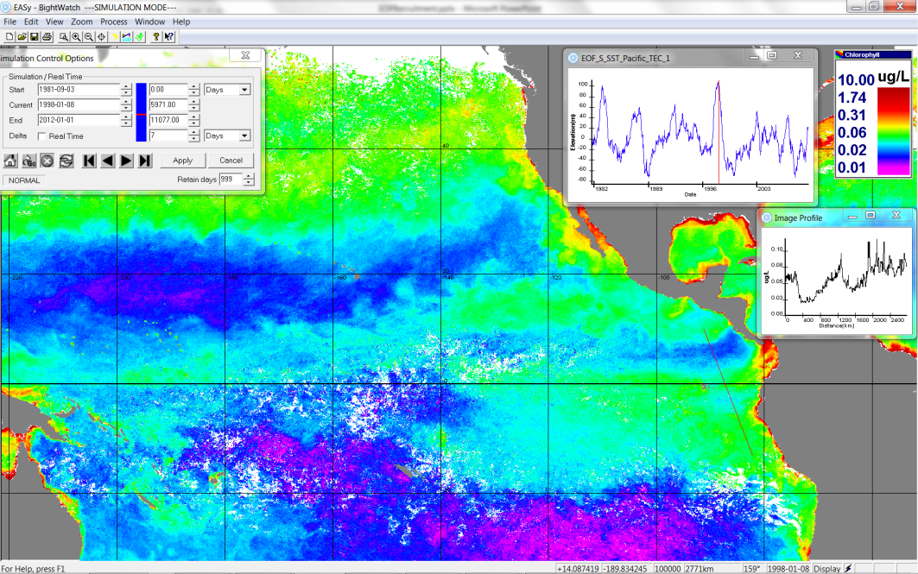
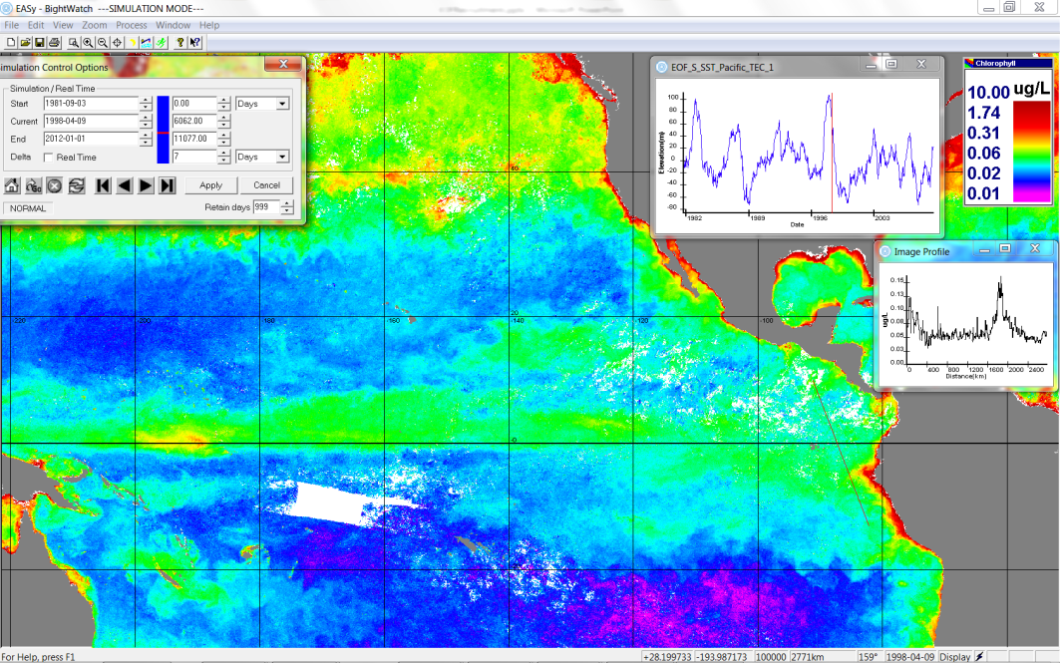
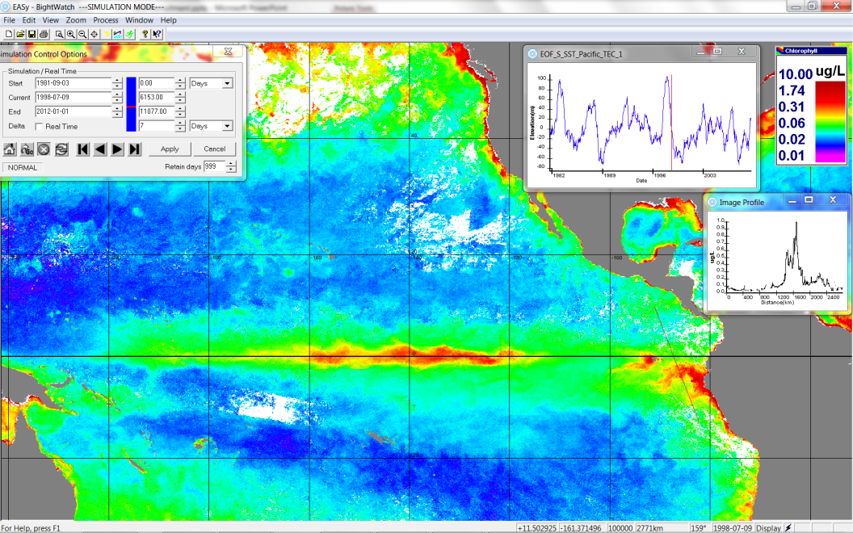
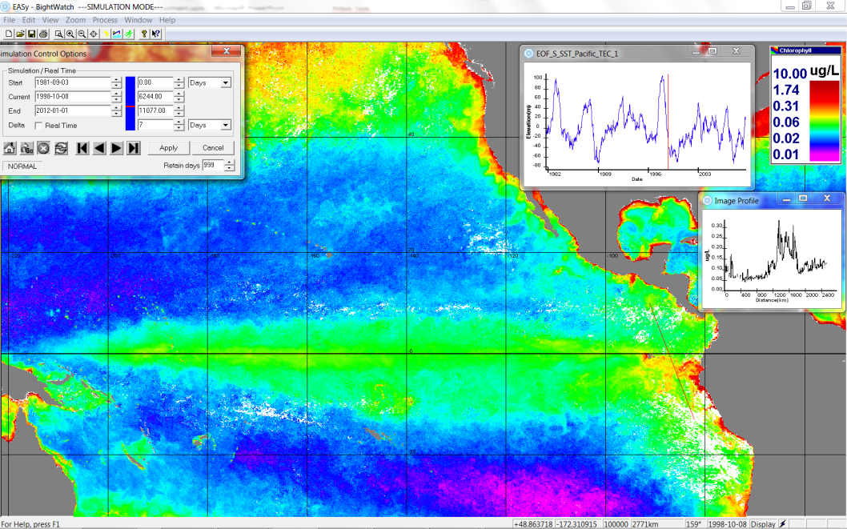
yellowfin strong cohorts are newborn
strong cohorts are 3 months old
strong cohorts are 6 months old
strong cohort are 9 months old

Slide 11
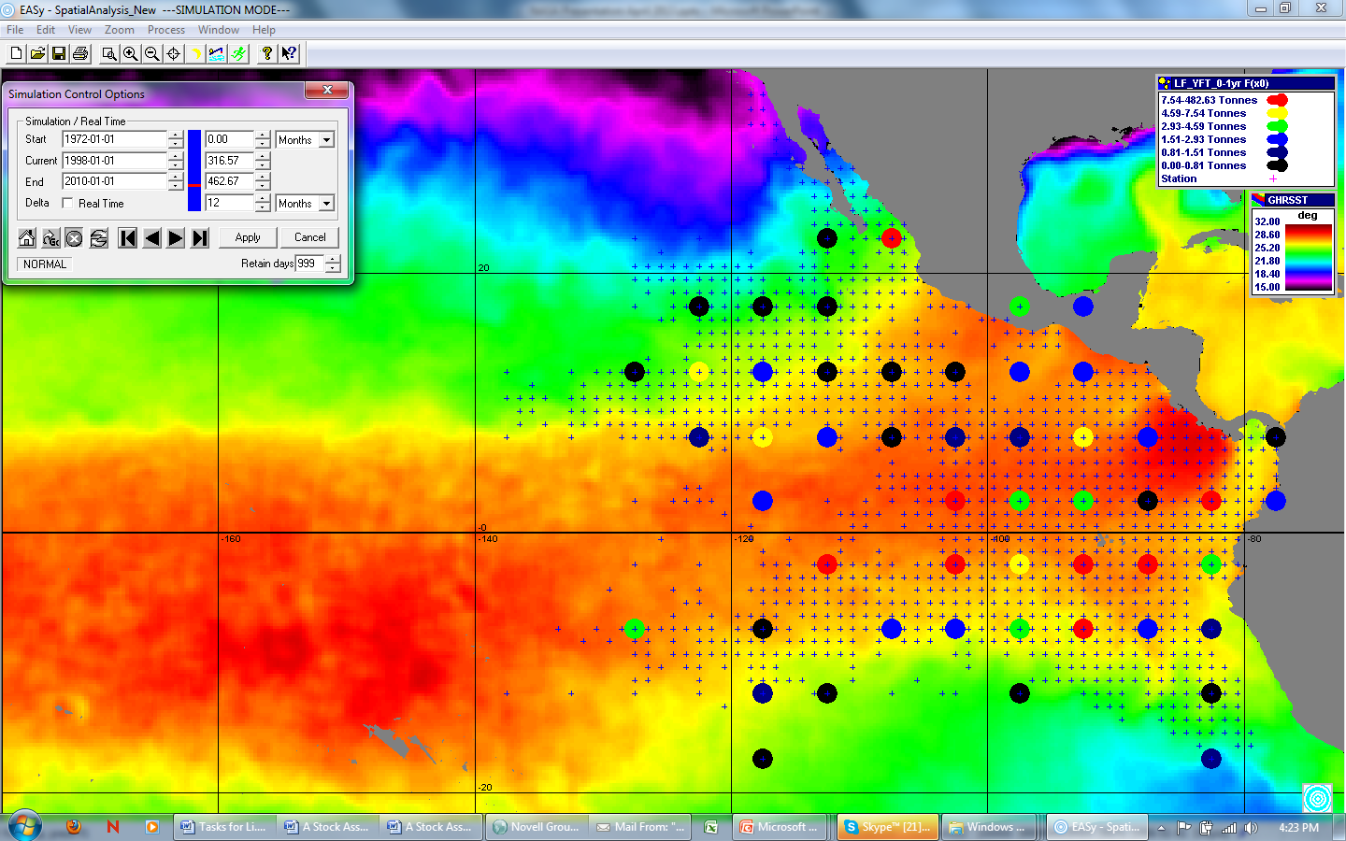
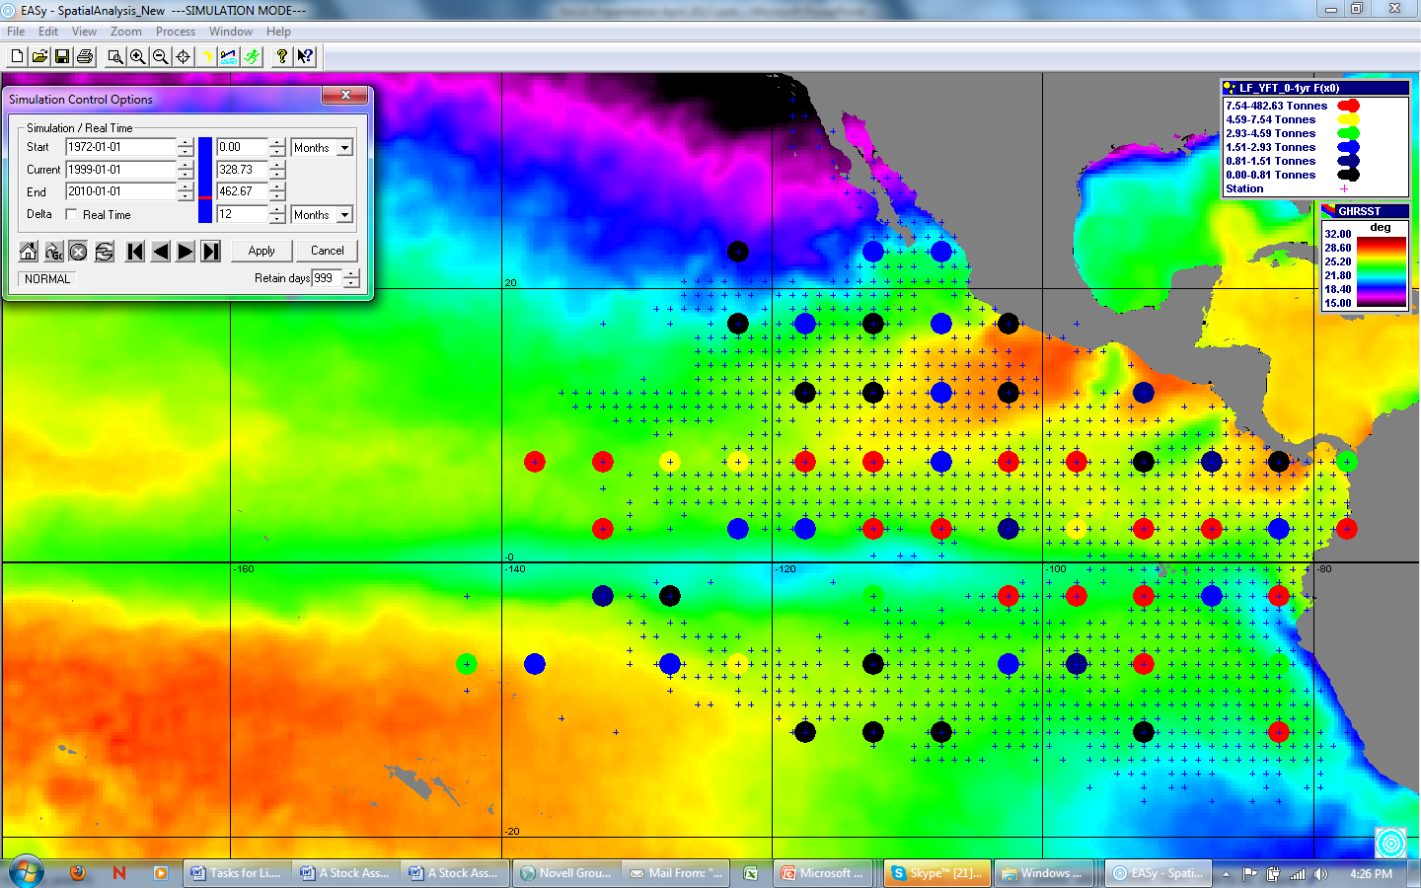
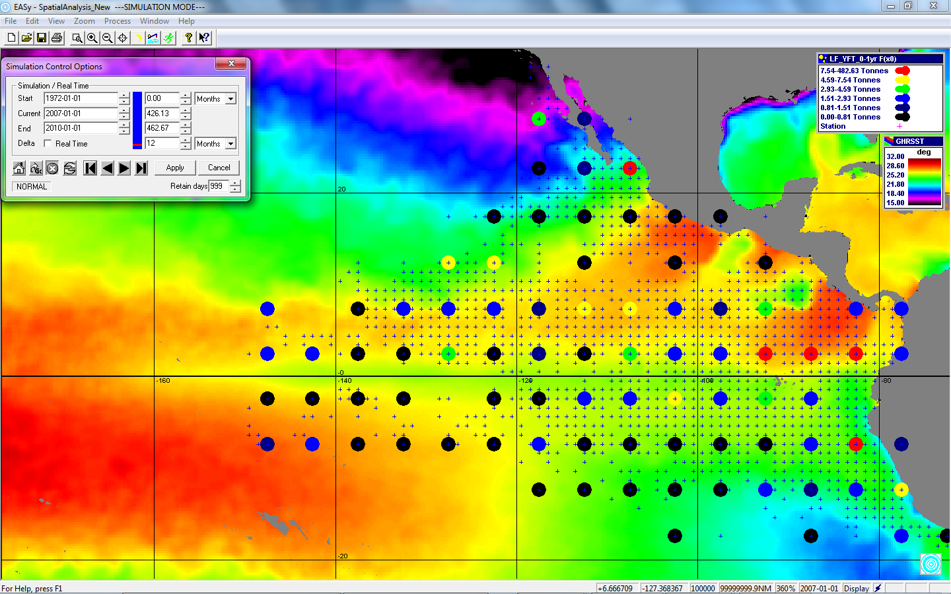
First year old yellow fin caught in 1997
prior to ENSO event
First year old yellow fin caught in 1998
during ENSO event
First year old yellow fin caught in 1999
following ENSO event

Slide 12
A. Langley 2008. Canadian Journal of Fisheries and Aquatic Sciences
Independent Variables: surface temperature, surface temperature variability ,
zonal winds, mixed layer depth

Slide 13
Comparison of oceanographic predicted yellowfinrecruitment to that calculated with Inter-American Tropical Tuna Comission’s stock assessment model

Slide 14
Conclusions
We have successfully predicted recruitment of tuna of the eastern Pacific from satellite imagery of sea surface temperate and chlorophyll.
We believe that within the next few years such predictions will support stock assessment models.

